Slide 1
Jagwire - ENVI analytics
Using Web-based Analytics in Jagwire
For ESRI - Vietnam
November 3, 2021
JOE COLE | Sales Engineering

Slide 2
Course Overview
Jagwire Review (as needed)
Web-based Analytics in Jagwire
Anomaly Detection
Barren Land
Classification
Coastline Detection
General Land Use
Land Mask
MNF Transform
Orthorectification
Spectral Index Task
Vegetation
Water

Slide 3
Anomaly Detection Task
Description: The task executes anomaly detection
Image Used: tsunami_after
Output Type: Shapefile

Slide 4
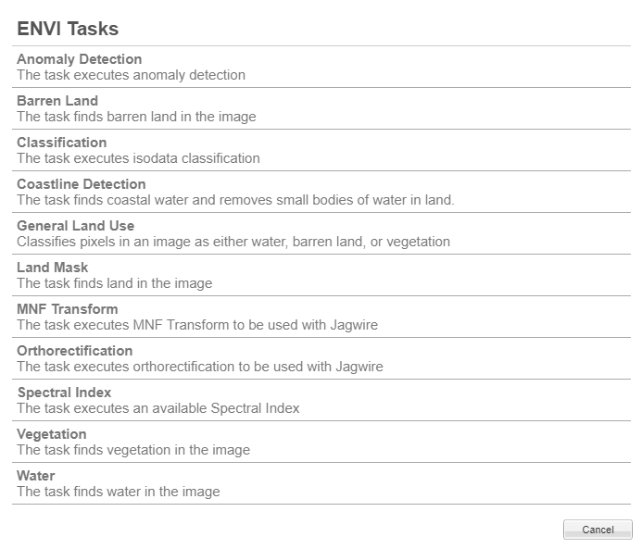
Anomaly Detection
Select Image
Click on the Wrench icon to open the list of ENVI Tasks
Select “Anomaly Detection”

Slide 5
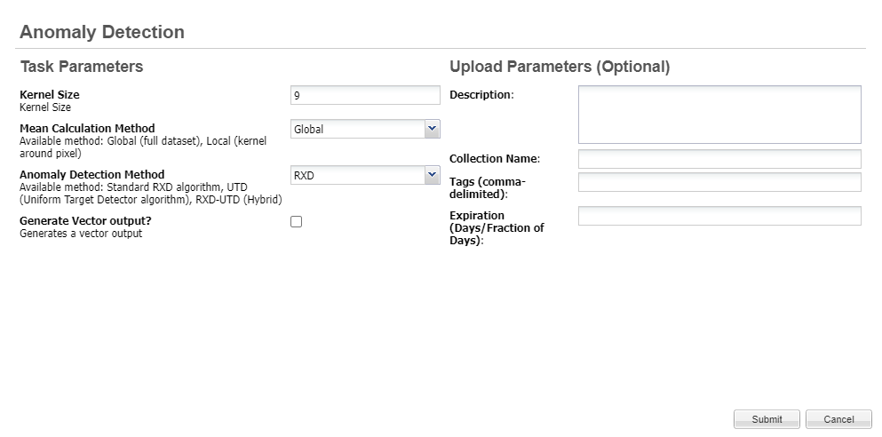
Anomaly Detection Task
4. Add any input parameters and submit.
Be sure to check the
Generate Vector Output box to create shapefile
Click “Submit” Button

Slide 6
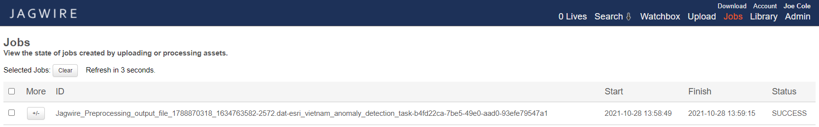
Anomaly Detection Task
5. Check status on “Jobs” page.
When Status shows “SUCCESS” go back to
main Search page to find the product.

Slide 7
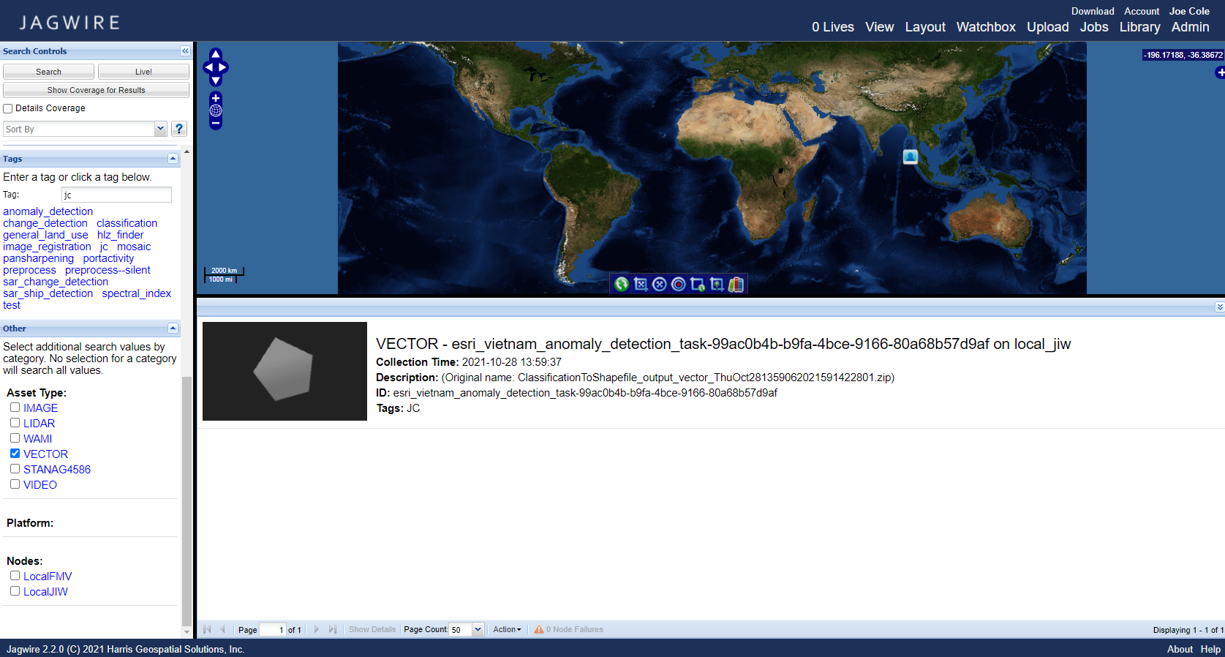
Anomaly Detection Task
6. Search for output in search page

Slide 8
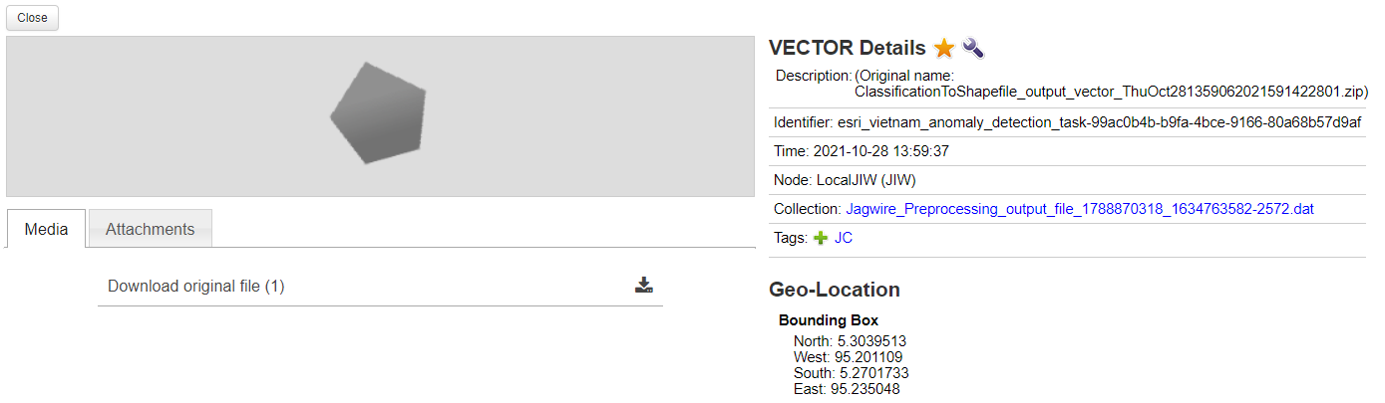
Anomaly Detection Task
7. Select product and download
Click here to Download

Slide 9
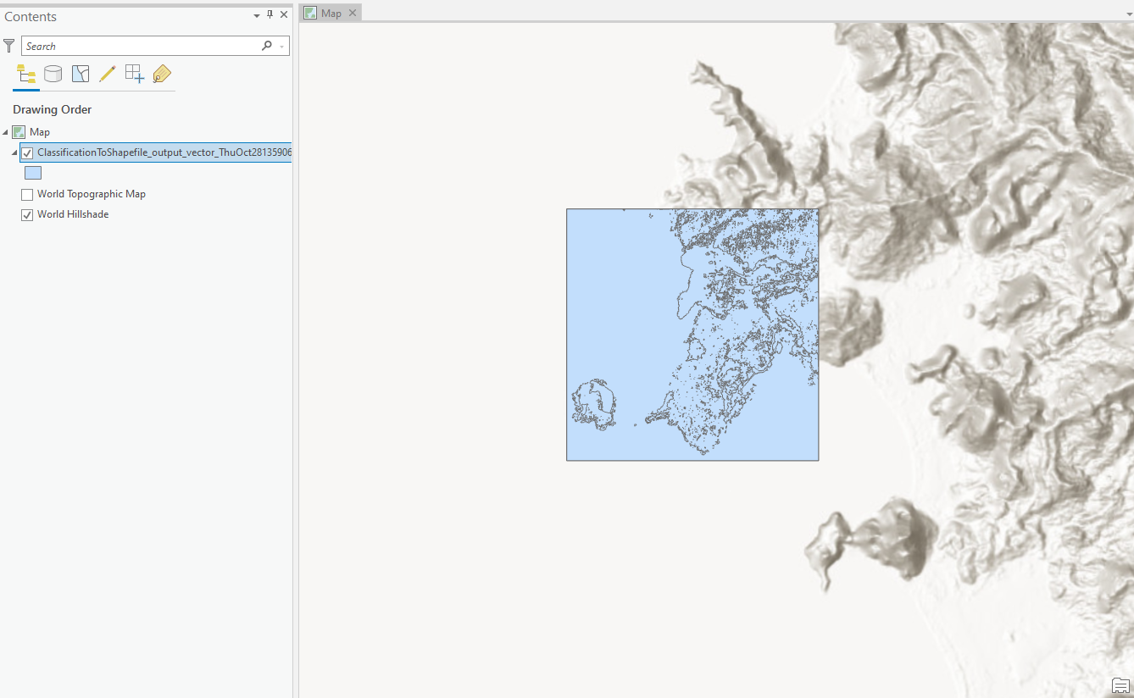
Anomaly Detection Task
8. Import into ArcGIS or ENVI for analysis

Slide 10
Barren Land Task
Description: The Barren Land task uses two thresholds to classify barren land in the image. The lower threshold should be the threshold between land and water (usually roughly -0.1). The upper threshold should be the threshold of healthy vegetation (roughly .1). Pixels with NDVI values above the lower threshold and below the upper threshold will be classified as barren land.
This task requires Multispectral/Hyperspectral data that include RED and NIR bands
Image Used: tsunami_after
Output Type: Shapefile

Slide 11
Barren Land Task
Select Image
Click on the Wrench icon to open the list of ENVI Tasks
Select “Barren Land”

Slide 12
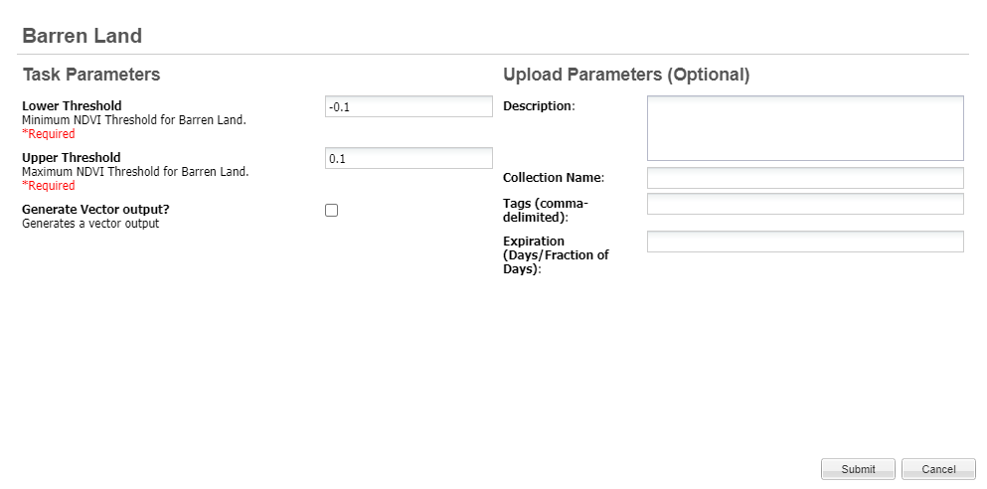
Barren Land Task
4. Add any input parameters and submit.
Be sure to check the
Generate Vector Output box to create shapefile
Click “Submit” Button

Slide 13
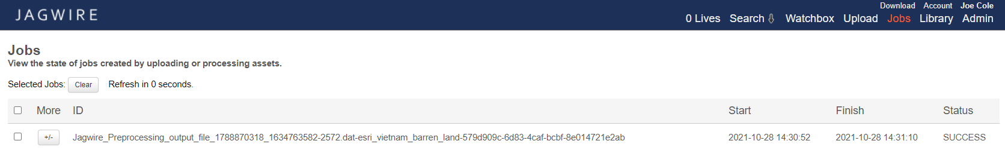
Barren Land Task
5. Check status on “Jobs” page.
When Status shows “SUCCESS” go back to
main Search page to find the product.

Slide 14
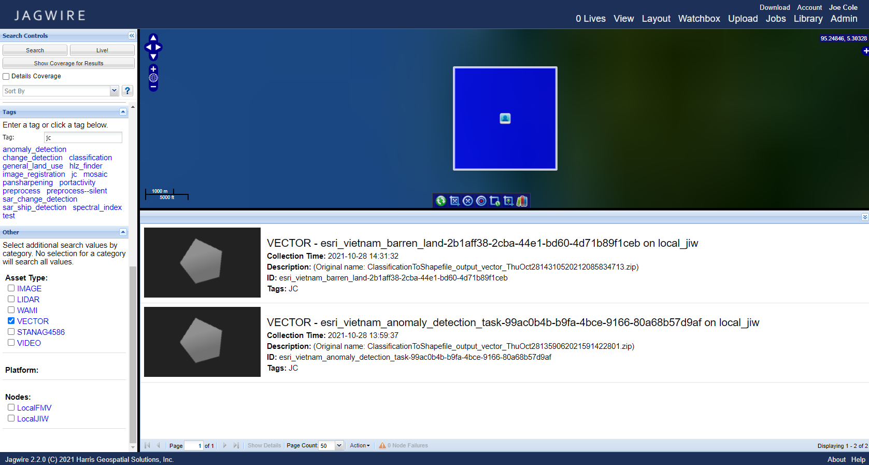
Barren Land Task
6. Search for output in search page

Slide 15
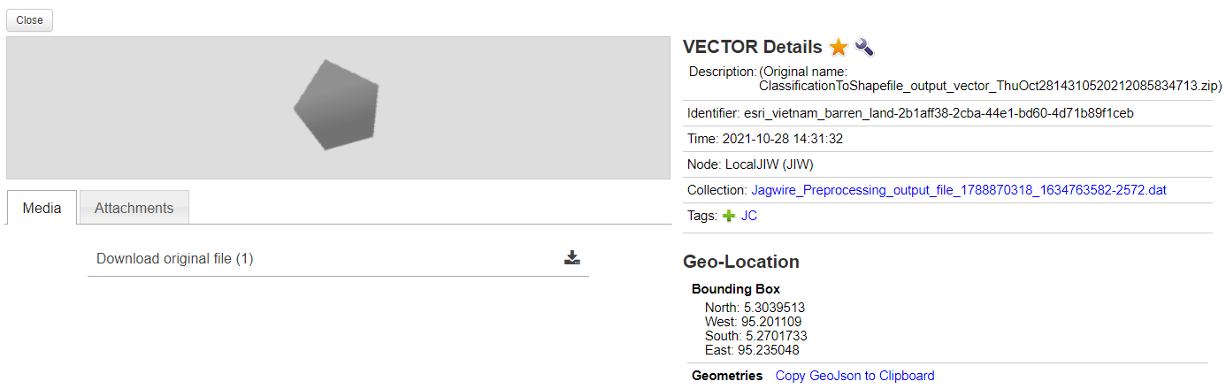
Barren Land Task
7. Select product and download
Click here to Download

Slide 16
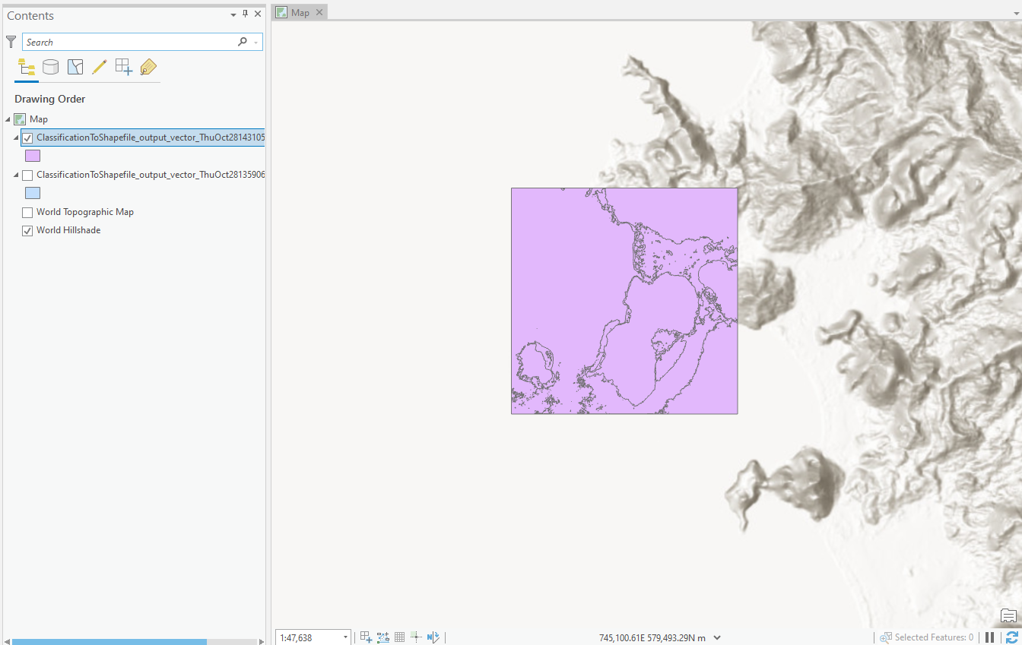
Barren Land Task
8. Import into ArcGIS or ENVI for analysis

Slide 17
Classification Task
Description: The task executes image classification
Image Used: tsunami_before
Output Type: Shapefile

Slide 18
Classification Task
Select Image
Click on the Wrench icon to open the list of ENVI Tasks
Select “Classification”

Slide 19
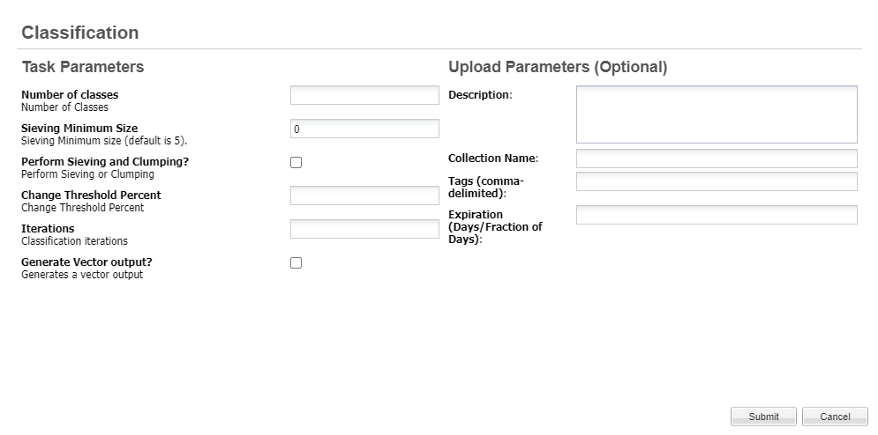
Classification Task
4. Add any input parameters and submit.
Be sure to check the
Generate Vector Output box to create shapefile
Click “Submit” Button

Slide 20
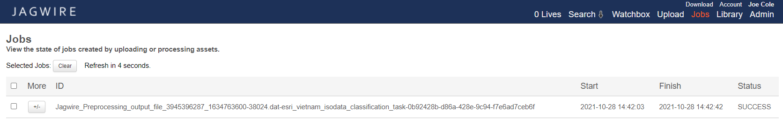
Classification Task
5. Check status on “Jobs” page.
When Status shows “SUCCESS” go back to
main Search page to find the product.

Slide 21
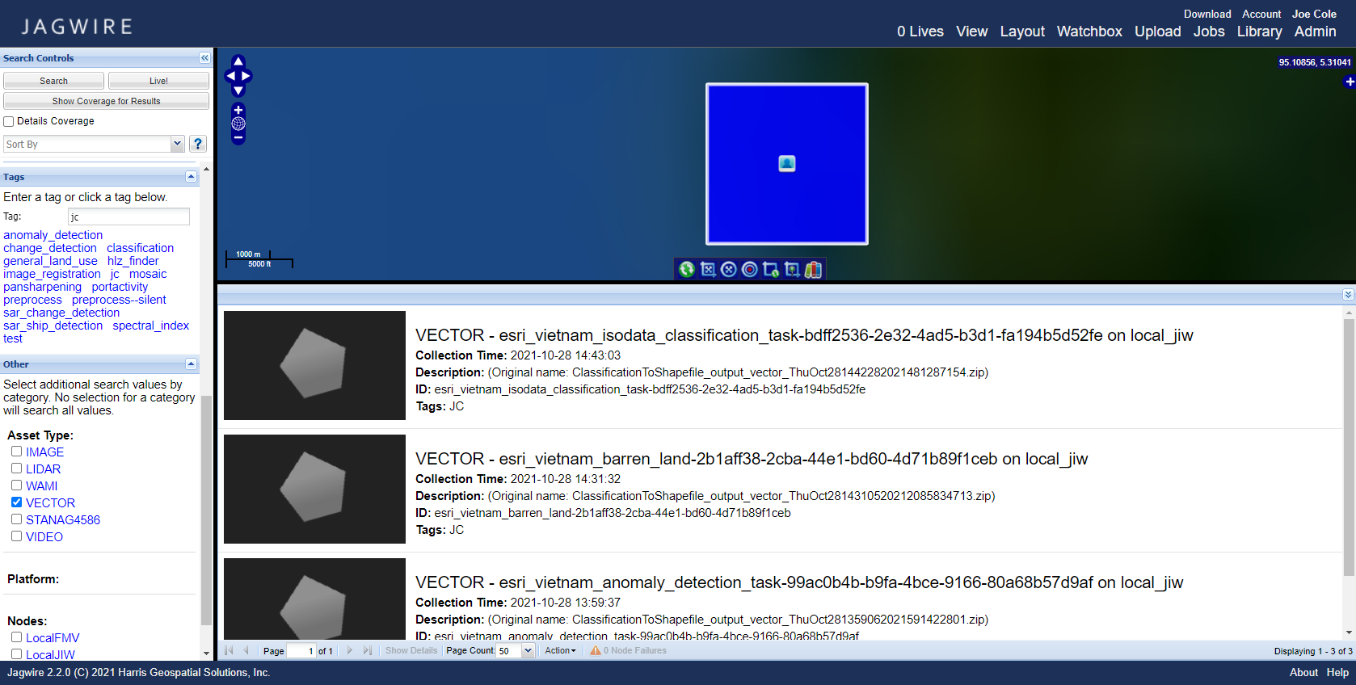
Classification Task
6. Search for output in search page

Slide 22
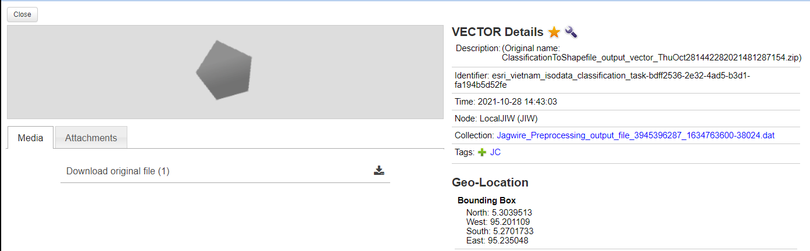
Classification Task
7. Select product and download
Click here to Download

Slide 23
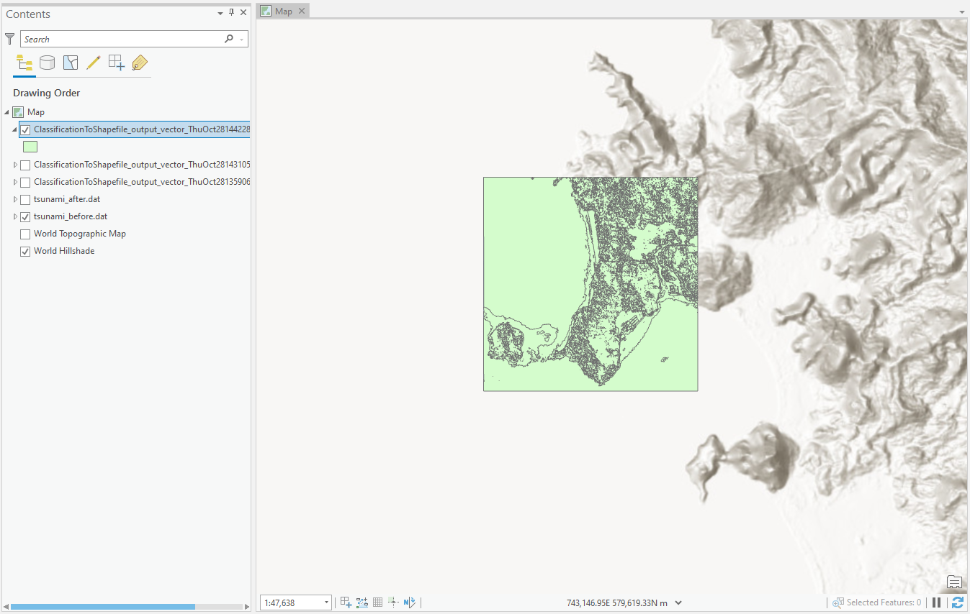
Classification Task
8. Import into ArcGIS or ENVI for analysis

Slide 24
Coastline Detection Task
Description: This task finds water and removes small bodies of water in land. This tasks uses NDVI and a threshold to determine the locations of water. It then manipulates to resulting mask to remove small bodies of water. The parameter Shrink-Grow area roughly corresponds to the size of the bodies of water that will be filtered out. The mask processing will be done iteratively. The number of pixels per iteration can be defined using the “Pixel Per Iteration”
Requires Multispectral/Hyperspectral data that include RED and NIR bands
Image Used: tsunami_before
Output Type: Shapefile

Slide 25
Coastline Detection Task
Select Image
Click on the Wrench icon to open the list of ENVI Tasks
Select “Coastline Detection”

Slide 26
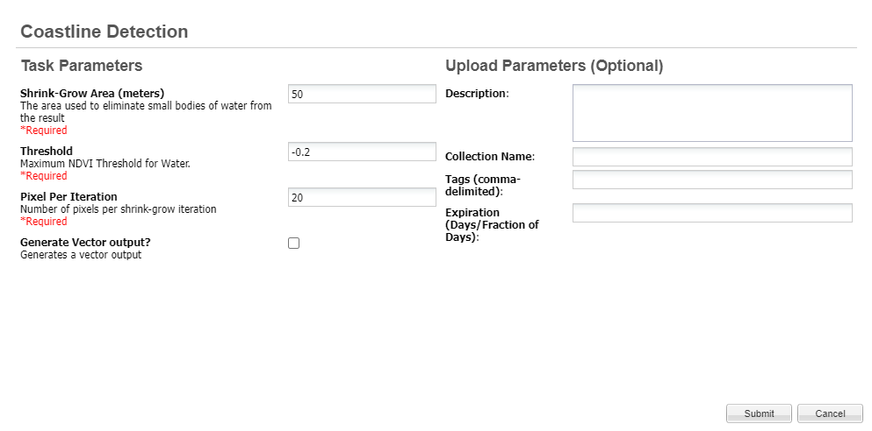
Coastline Detection Task
4. Add any input parameters and submit.
Be sure to check the
Generate Vector Output box to create shapefile
Click “Submit” Button

Slide 27
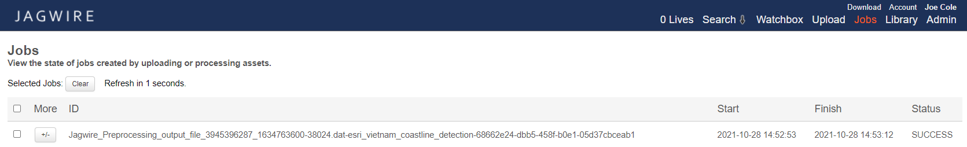
Coastline Detection Task
5. Check status on “Jobs” page.
When Status shows “SUCCESS” go back to
main Search page to find the product.

Slide 28

Coastline Detection Task
6. Search for output in search page

Slide 29
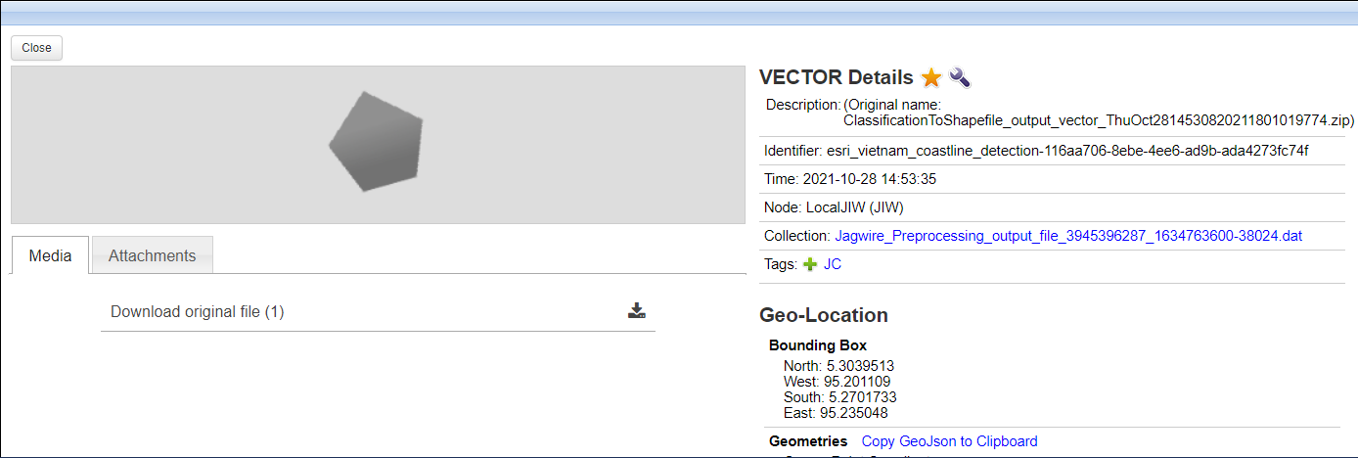
Coastline Detection Task
7. Select product and download
Click here to Download

Slide 30
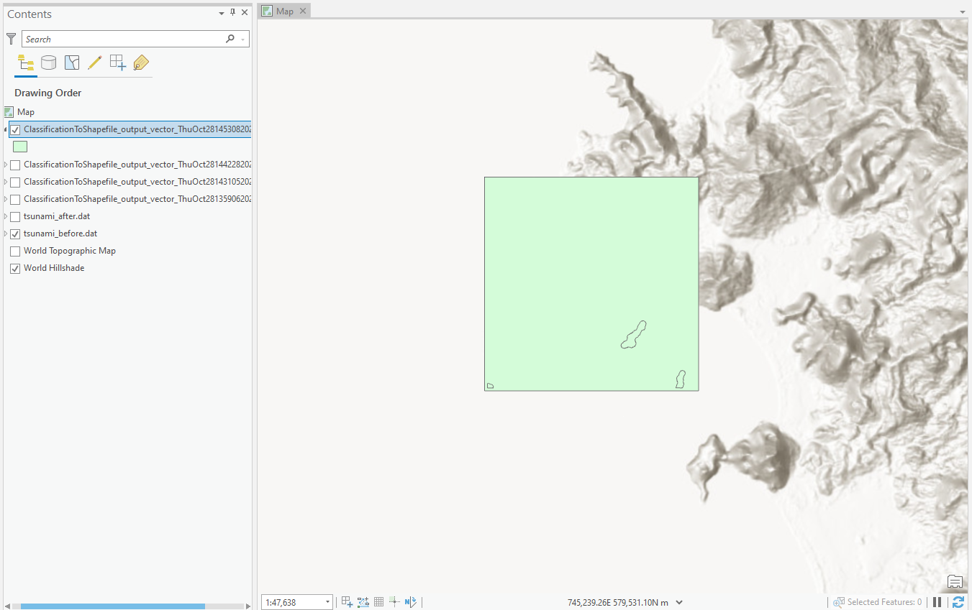
Coastline Detection Task
8. Import into ArcGIS or ENVI for analysis

Slide 31
General Land Use Task
Description: The General Land Use task uses Uses NDVI and two thresholds to classify water, barren land, and vegetation in the image. The water threshold should be the threshold between land and water (usually roughly -0.1). The vegetation threshold should be the threshold of healthy vegetation (roughly .1).
Pixels with NDVI values:
-Below the water threshold is classified as water
-Above the water threshold and below the vegetation threshold will be classified as barren land.
-Above the vegetation threshold will be classified as vegetation.
Requires Multispectral/Hyperspectral data that include RED and NIR bands
Image Used: tsunami_before
Output File: Shapefile

Slide 32
General Land Use Task
Select Image
Click on the Wrench icon to open the list of ENVI Tasks
Select “General Land Use”

Slide 33

General Land Use Task
4. Add any input parameters and submit.
Be sure to check the
Generate Vector Output box to create shapefile
Click “Submit” Button

Slide 34
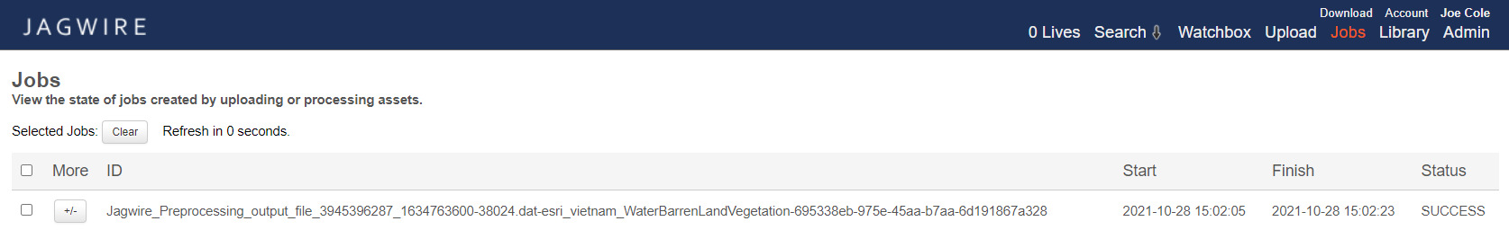
General Land Use Task
5. Check status on “Jobs” page.
When Status shows “SUCCESS” go back to
main Search page to find the product.

Slide 35

General Land Use Task
6. Search for output in search page

Slide 36
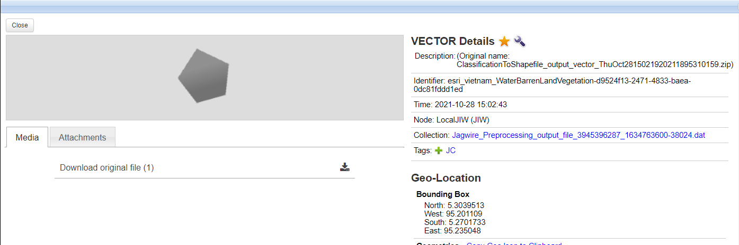
General Land Use Task
7. Select product and download
Click here to Download

Slide 37
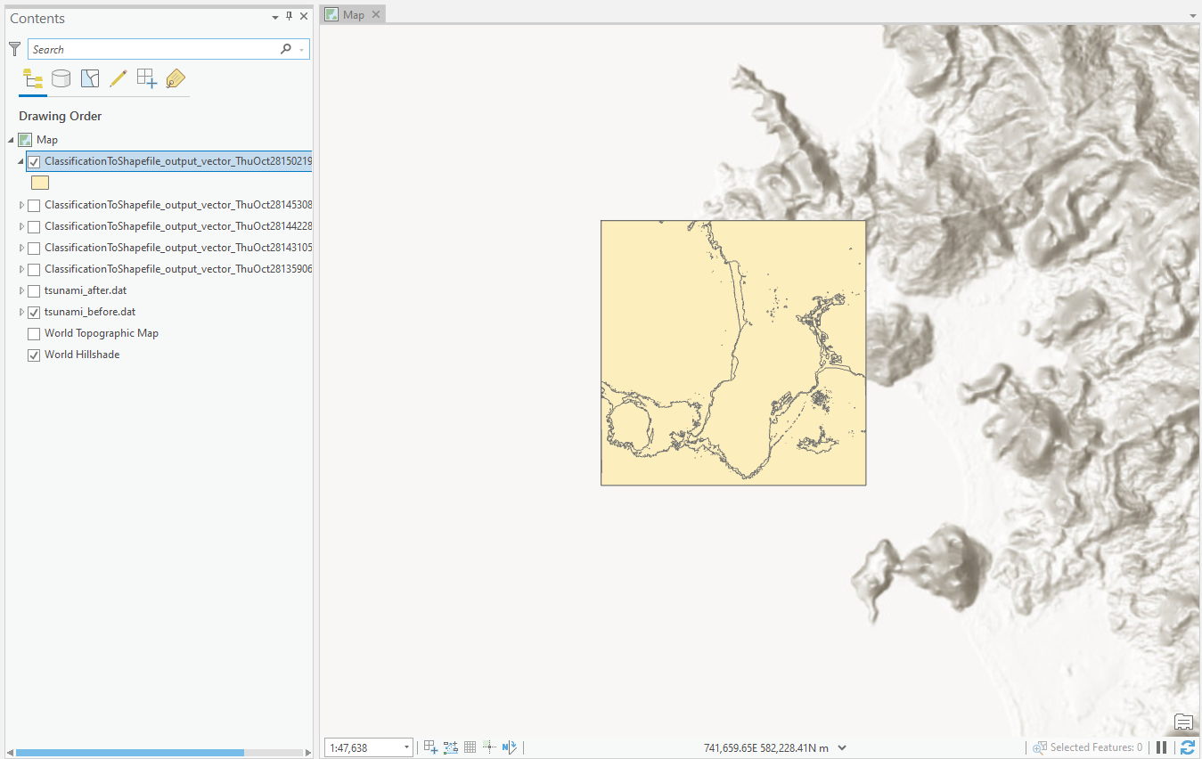
General Land Use Task
8. Import into ArcGIS or ENVI for analysis

Slide 38
Land Mask Task
Description: The Land Mask task uses NDVI and threshold to classify land in the image . Pixels with NDVI values above the threshold will be classified as land.
Requires Multispectral/Hyperspectral data that include RED and NIR bands
Image Used: tsunami_before
Output File: Shapefile

Slide 39
Land Mask Task
Select Image
Click on the Wrench icon to open the list of ENVI Tasks
Select “Land Mask”

Slide 40
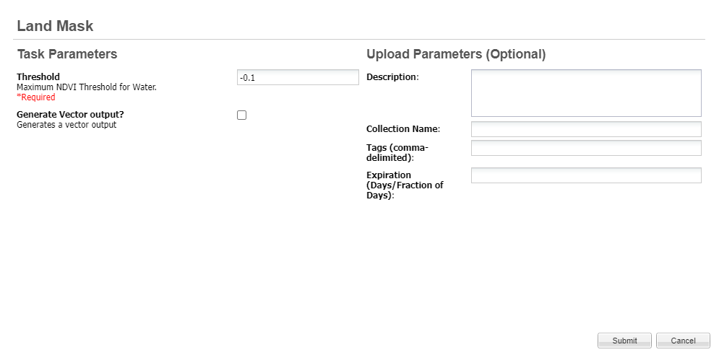
Land Mask Task
4. Add any input parameters and submit.
Be sure to check the
Generate Vector Output box to create shapefile
Click “Submit” Button

Slide 41
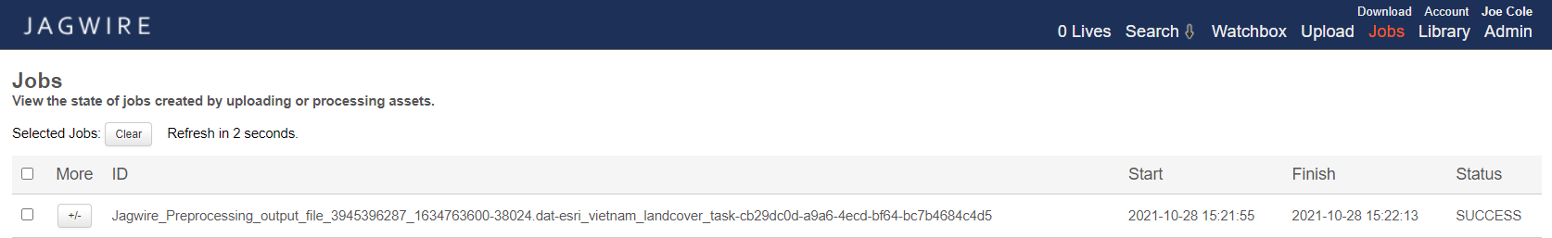
Land Mask Task
5. Check status on “Jobs” page.
When Status shows “SUCCESS” go back to
main Search page to find the product.

Slide 42
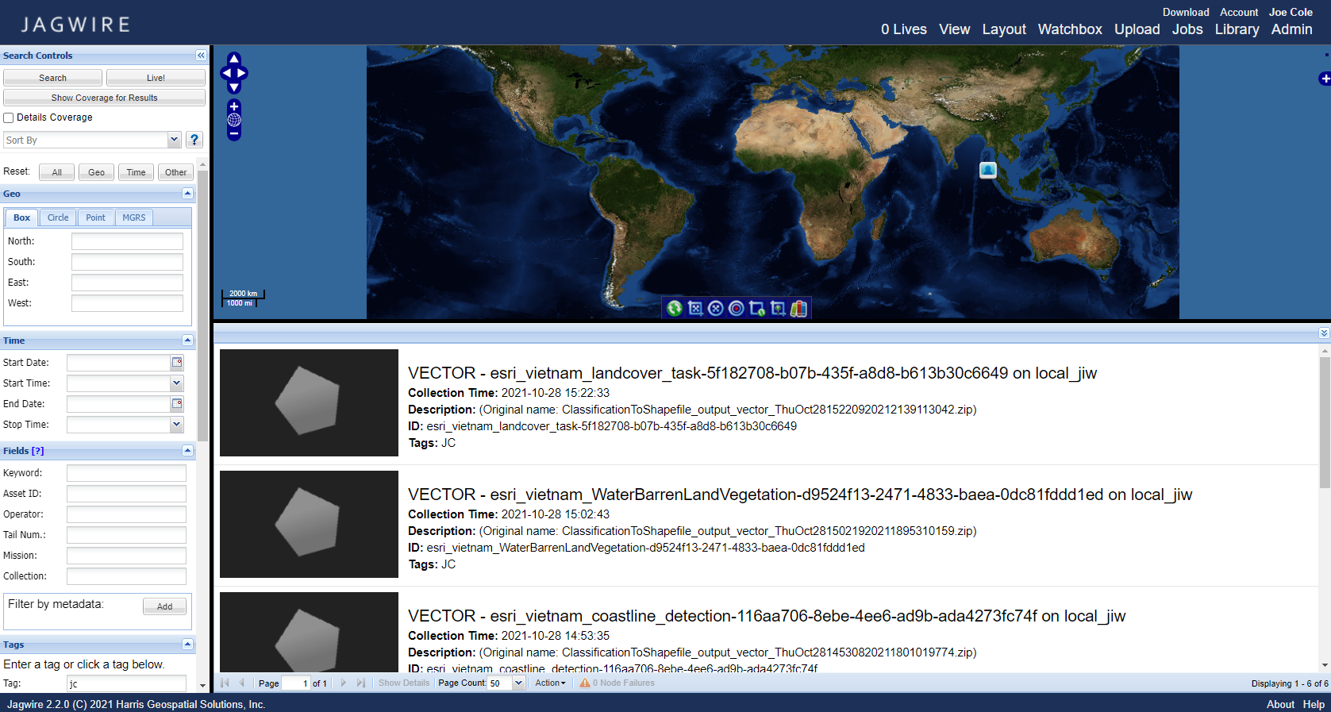
Land Mask Task
6. Search for output in search page

Slide 43
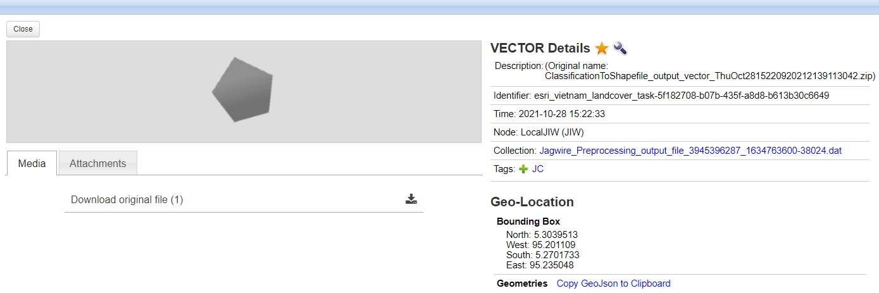
Land Mask Task
7. Select product and download
Click here to Download

Slide 44
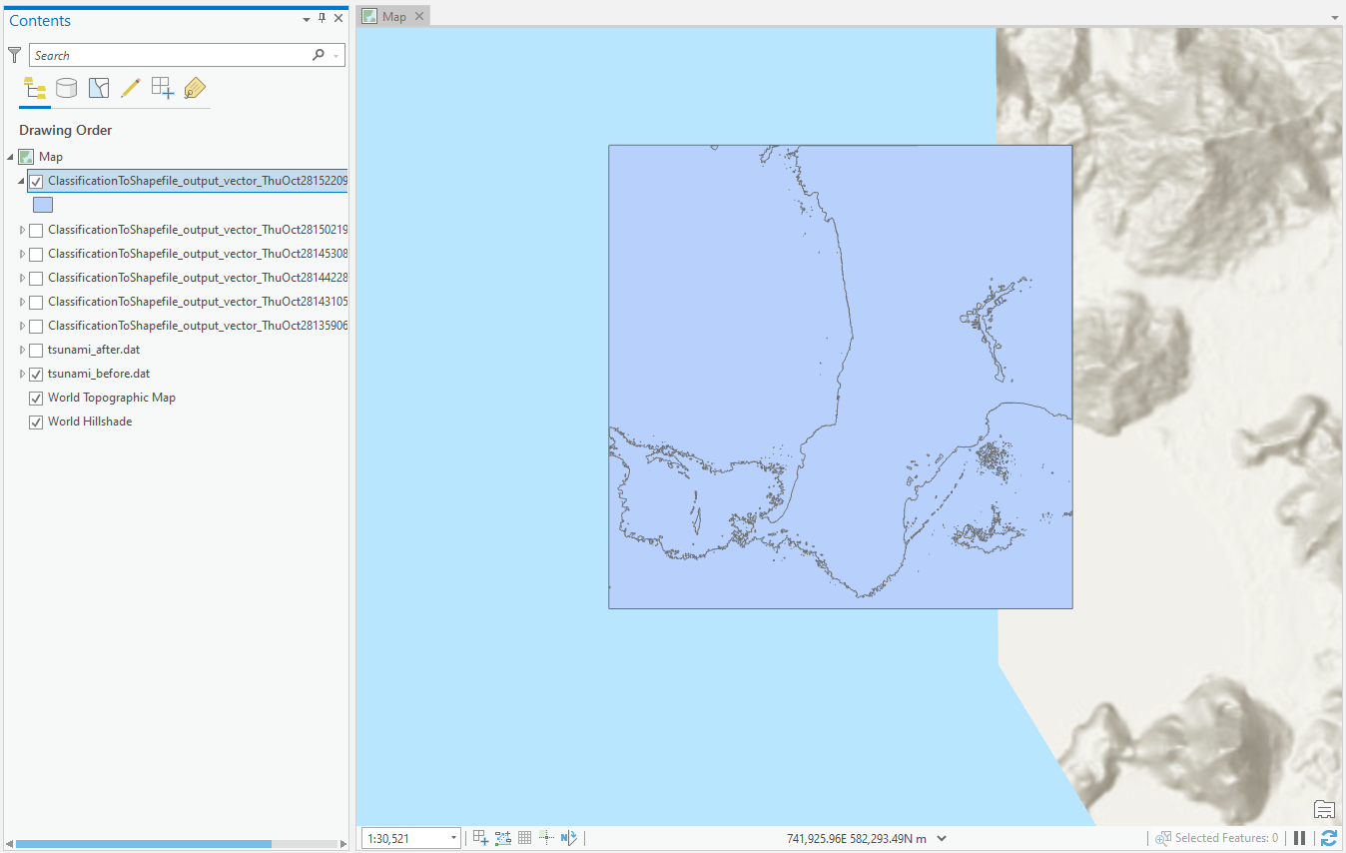
Land Mask Task
8. Import into ArcGIS or ENVI for analysis

Slide 45
Minimum Noise Fraction (MNF) Transform Task
Description: The MNF Transform task produces a product that can be used to reduce noise and computational intensity of subsequent processing.
More information on MNF Transform can be found in the ENVI documentation at the following link:
https://www.l3harrisgeospatial.com/docs/minimumnoisefractiontransform.html
Image Used: qb_boulder_msi
Output Type: Image file

Slide 46
Minimum Noise Fraction (MNF) Transform Task
Select Image
Click on the Wrench icon to open the list of ENVI Tasks
Select “MNF Transform”

Slide 47
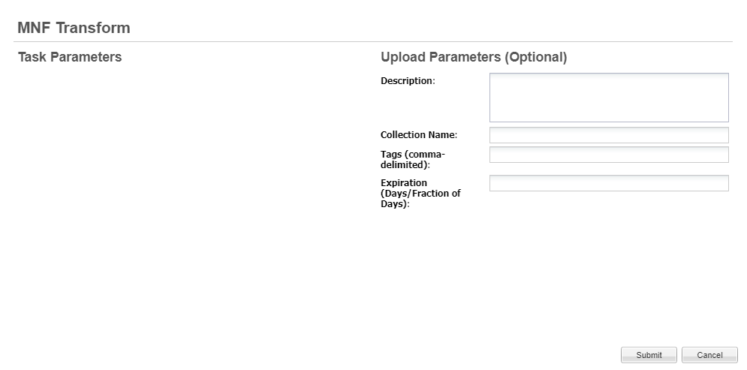
Minimum Noise Fraction (MNF) Transform Task
4. Add any input parameters and submit.
No Image Parameters Required
Click “Submit” Button

Slide 48
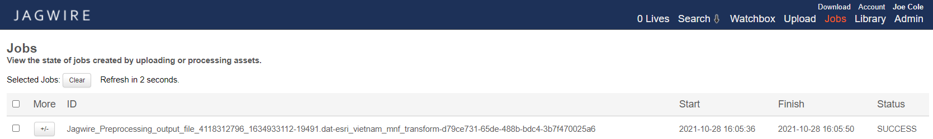
Minimum Noise Fraction (MNF) Transform Task
5. Check status on “Jobs” page.
When Status shows “SUCCESS” go back to
main Search page to find the product.

Slide 49
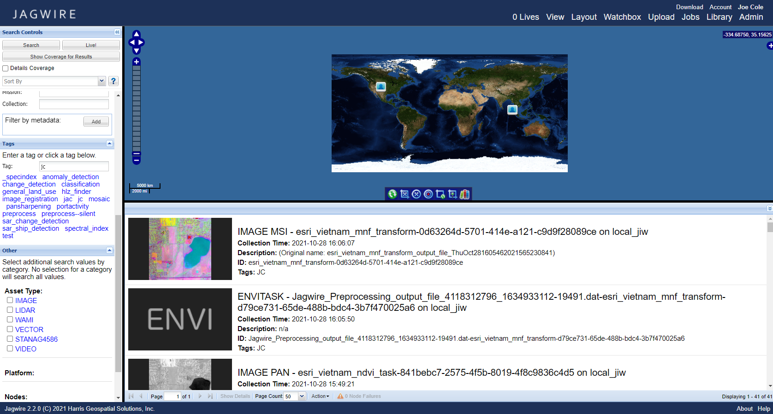
Minimum Noise Fraction (MNF) Transform Task
6. Search for output in search page

Slide 50
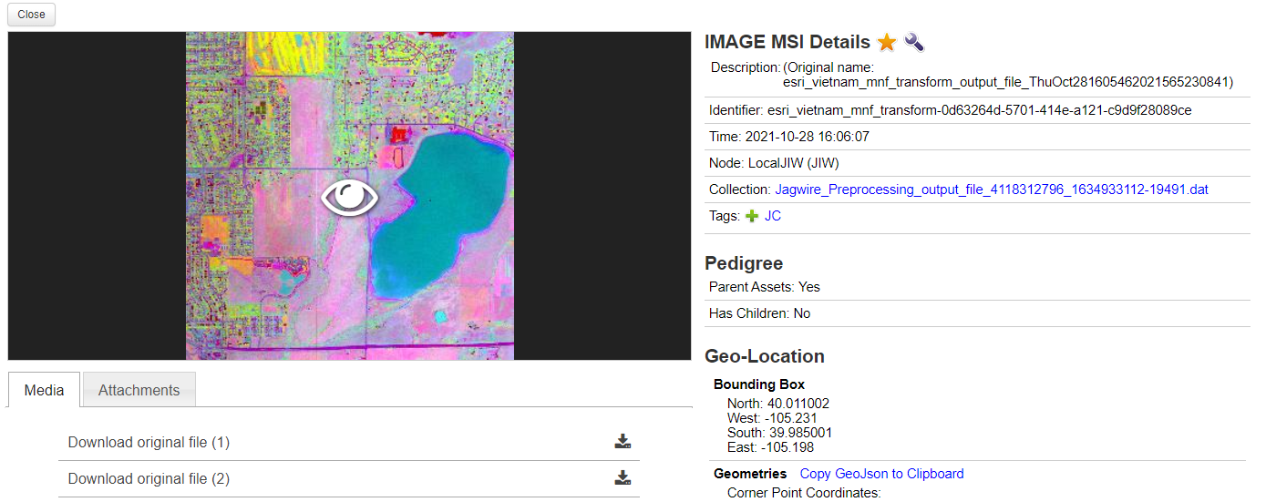
Minimum Noise Fraction (MNF) Transform Task
7. Select product and download
Download both dat and hdr files

Slide 51
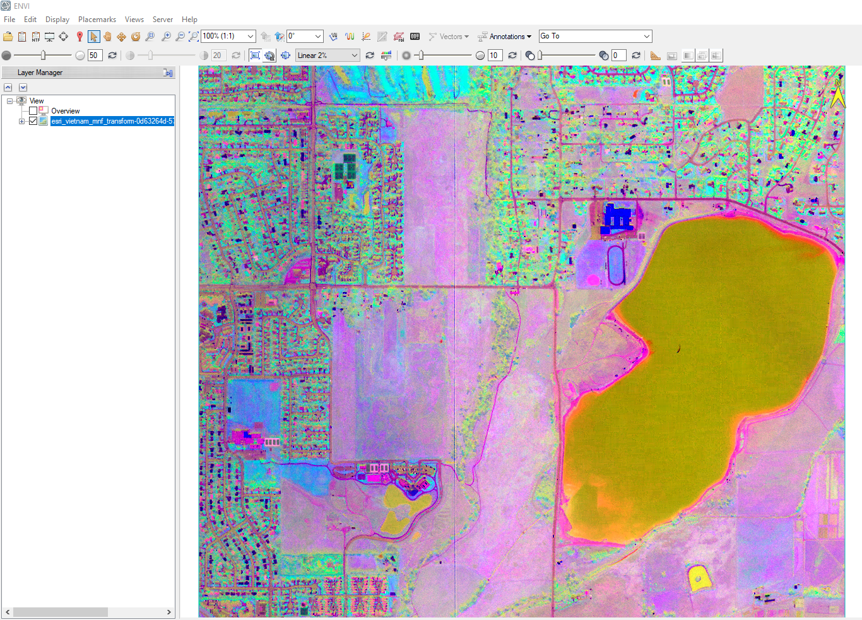
Minimum Noise Fraction (MNF) Transform Task
8. Import into ArcGIS or ENVI for analysis

Slide 52
Orthorectification Task
Description: Perform orthorectification of an image
Image Used: OrbViewSubset.dat
Output Type: Image File

Slide 53
Orthorectification Task
Select Image
Click on the Wrench icon to open the list of ENVI Tasks
Select “Orthorectification”

Slide 54
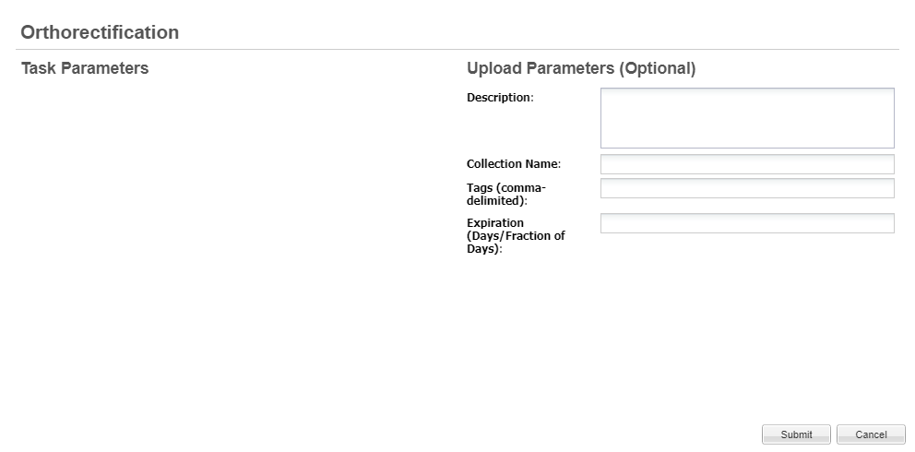
Orthorectification Task
4. Add any input parameters and submit.
No Image Parameters Required
Click “Submit” Button

Slide 55
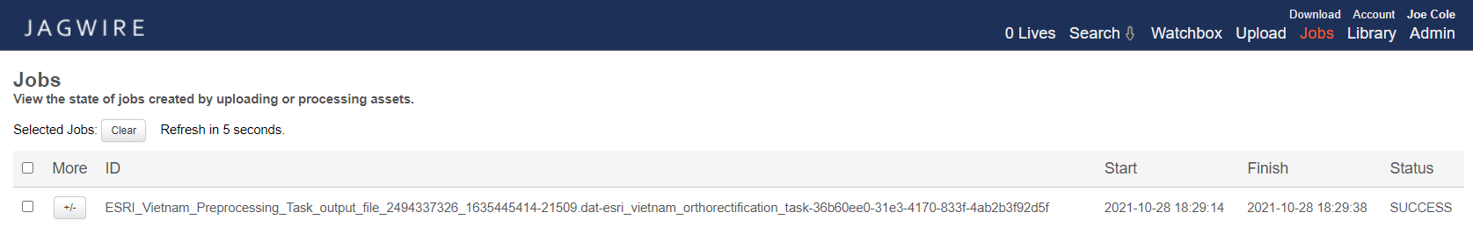
Orthorectification Task
5. Check status on “Jobs” page.
When Status shows “SUCCESS” go back to
main Search page to find the product.

Slide 56
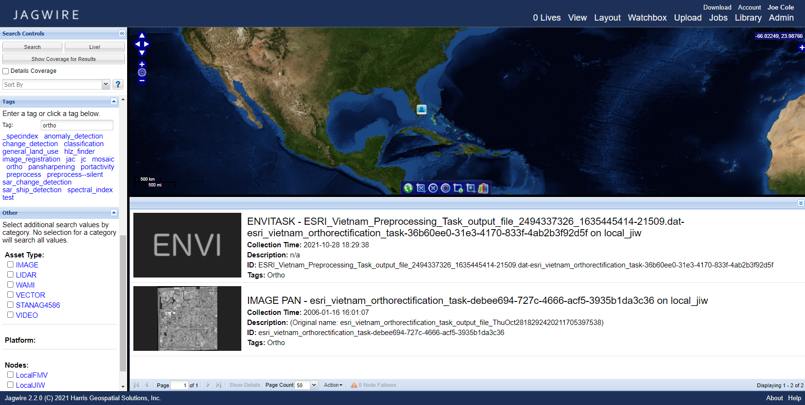
Orthorectification Task
6. Search for output in search page

Slide 57
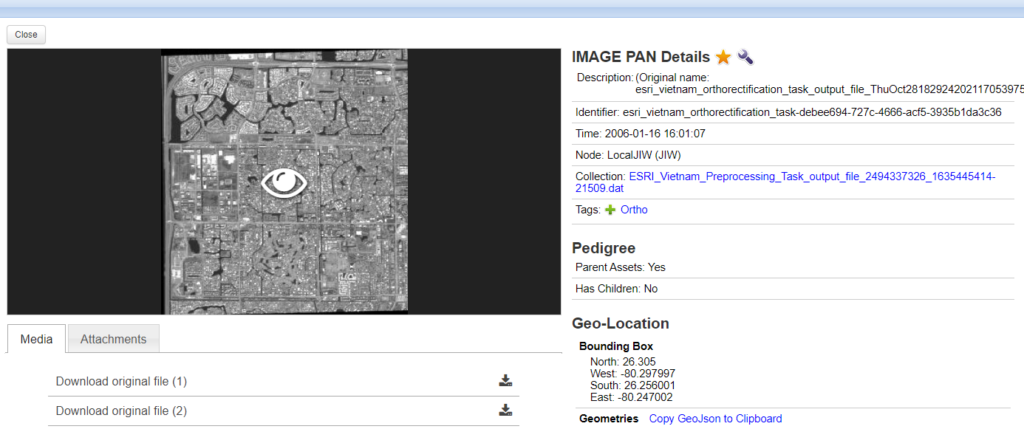
Orthorectification Task
7. Select product and download
Download both dat and hdr files

Slide 58
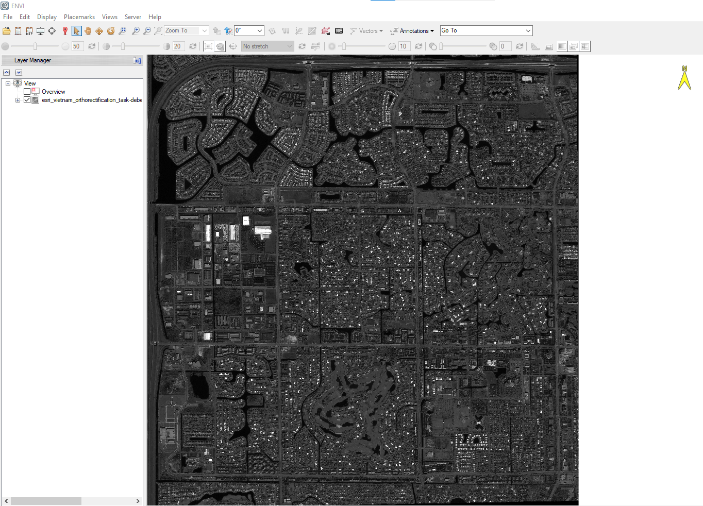
Orthorectification Task
8. Import into ArcGIS or ENVI for analysis

Slide 59
Spectral Index Task
Description: The task executes Spectral Index - There are 74 different Spectral Index to chose from
Image Used: qb_boulder_msi
Output Type: Image File

Slide 60
Spectral Index Task
Select Image
Click on the Wrench icon to open the list of ENVI Tasks
Select “Spectral Index”

Slide 61
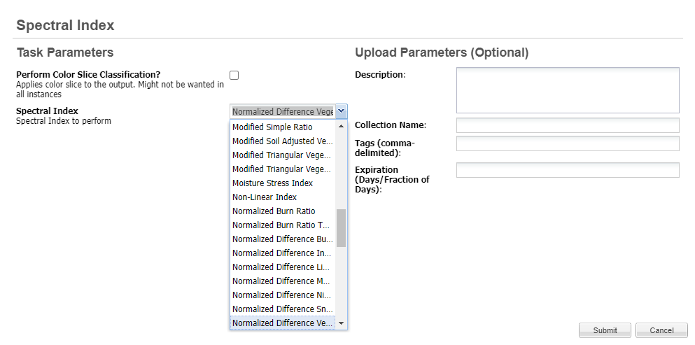
Spectral Index Task
4. Add any input parameters and submit.
No Image Parameters Required
Click “Submit” Button

Slide 62
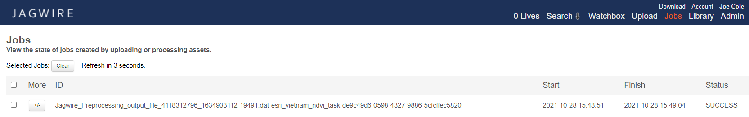
Spectral Index Task
5. Check status on “Jobs” page.
When Status shows “SUCCESS” go back to
main Search page to find the product.

Slide 63
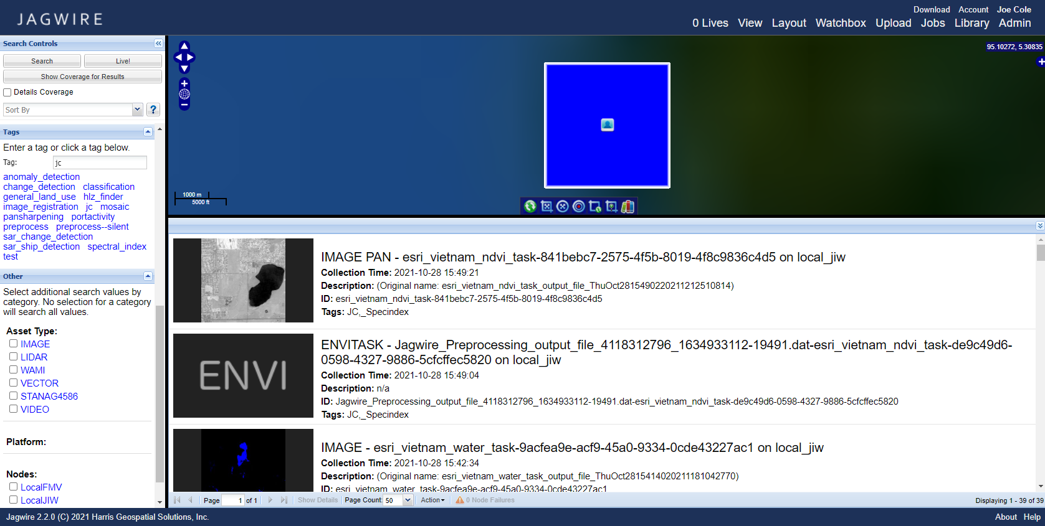
Spectral Index Task
6. Search for output in search page

Slide 64
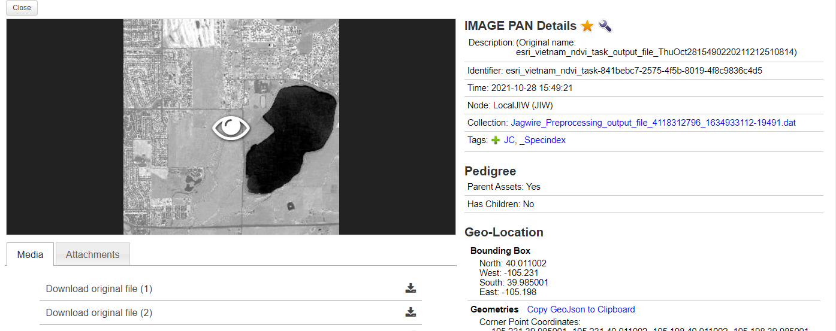
Spectral Index Task
7. Select product and download
Download both dat and hdr files

Slide 65
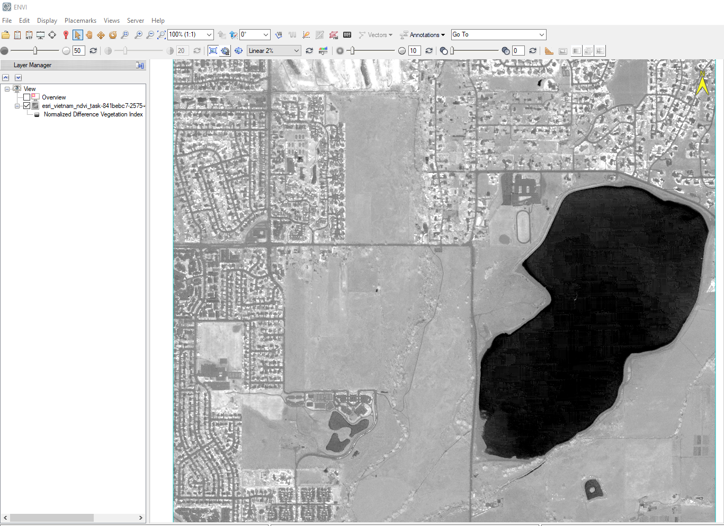
Spectral Index Task
8. Import into ArcGIS or ENVI for analysis

Slide 66
Vegetation Task
Description: The Vegetation Task uses NDVI and threshold to classify vegetation in the image. Pixels with NDVI values above the threshold will be classified as vegetation.
Requires Multispectral/Hyperspectral data that include RED and NIR bands
Image Used: tsunami_before
Output File: Shapefile

Slide 67
Vegetation Task
Select Image
Click on the Wrench icon to open the list of ENVI Tasks
Select “Vegetation”

Slide 68

Vegetation Task
4. Add any input parameters and submit.
Be sure to check the
Generate Vector Output box to create shapefile
Click “Submit” Button

Slide 69
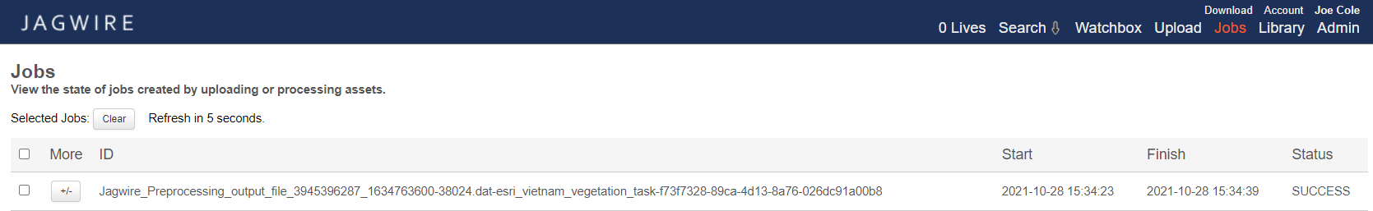
Vegetation Task
5. Check status on “Jobs” page.
When Status shows “SUCCESS” go back to
main Search page to find the product.

Slide 70

Vegetation Task
6. Search for output in search page

Slide 71
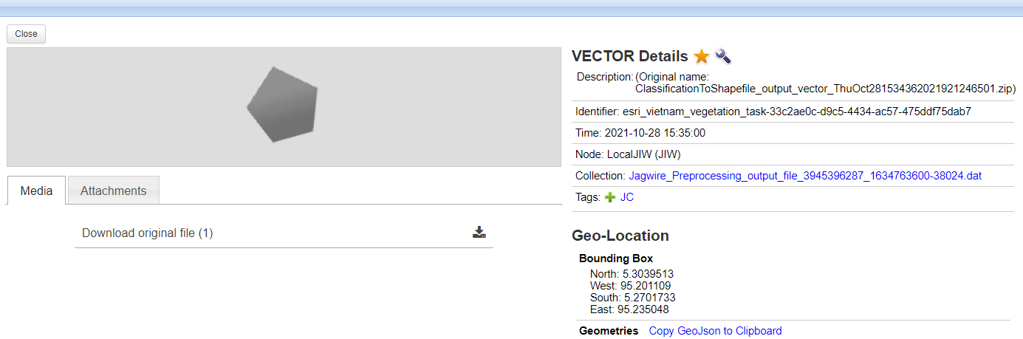
Vegetation Task
7. Select product and download
Click here to Download

Slide 72
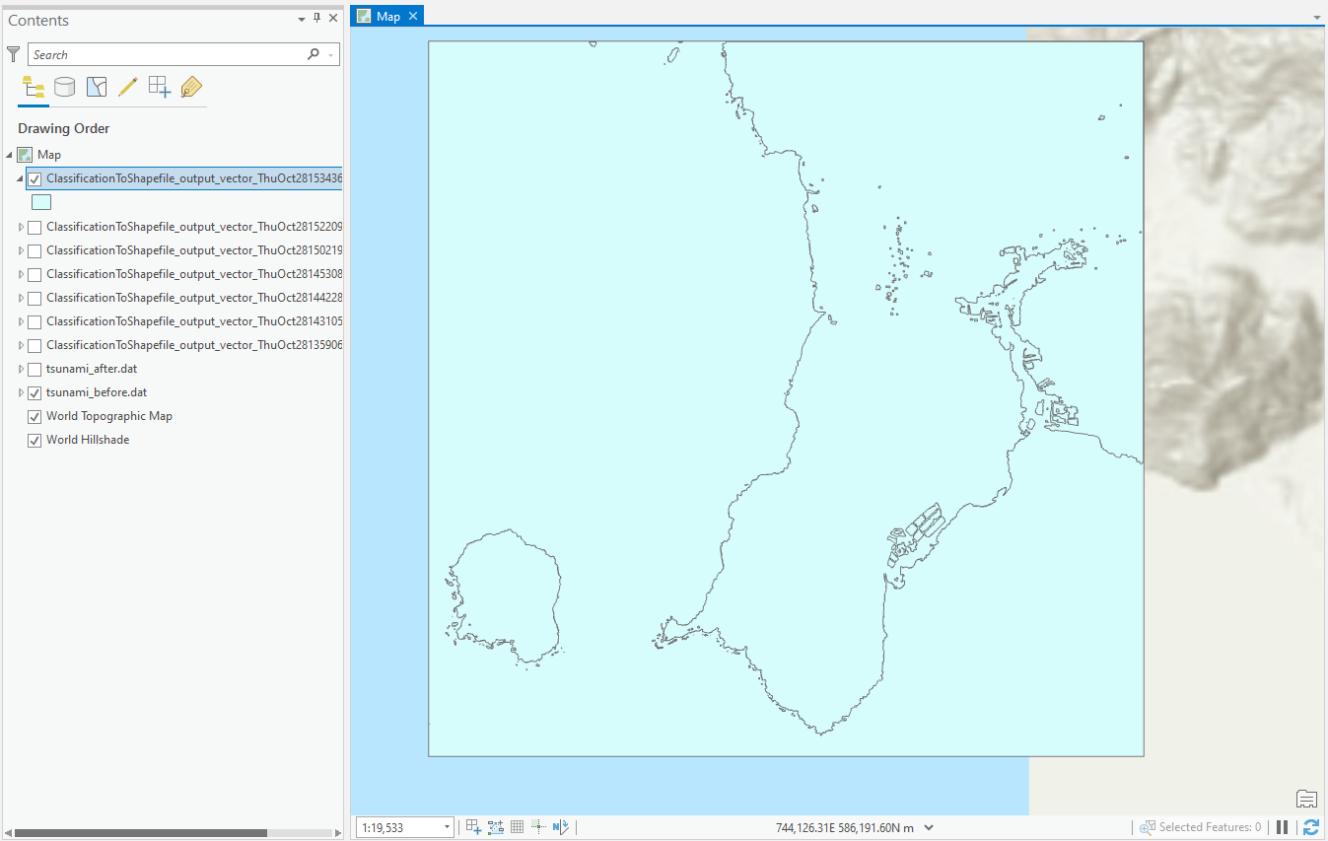
Vegetation Task
8. Import into ArcGIS or ENVI for analysis

Slide 73
Water Task
Description: The Water Task uses NDVI and threshold to classify land in the image. Pixels with NDVI values below the threshold will be classified as land.
Requires Multispectral/Hyperspectral data that include RED and NIR bands
Image Used: tsunami_after
Output Type: Shapefile

Slide 74
Water Task
Select Image
Click on the Wrench icon to open the list of ENVI Tasks
Select “Water”

Slide 75
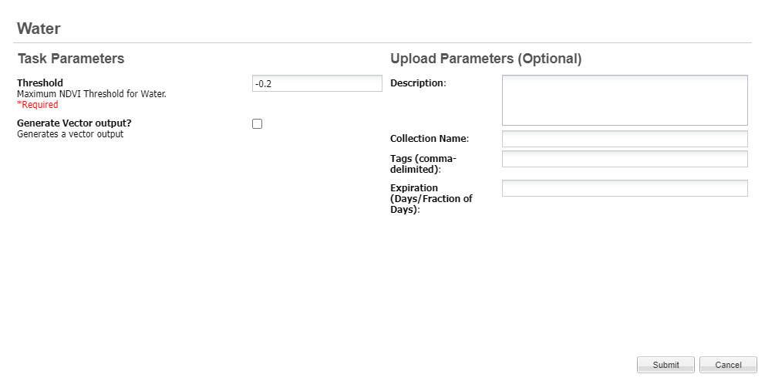
Water Task
4. Add any input parameters and submit.
Be sure to check the
Generate Vector Output box to create shapefile
Click “Submit” Button

Slide 76
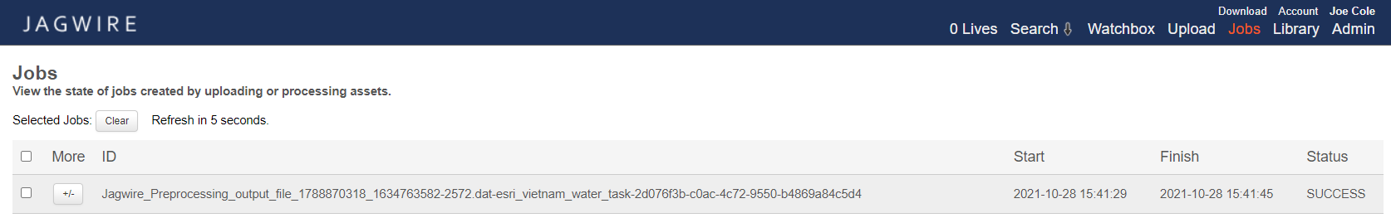
Water Task
5. Check status on “Jobs” page.
When Status shows “SUCCESS” go back to
main Search page to find the product.

Slide 77

Water Task
6. Search for output in search page

Slide 78
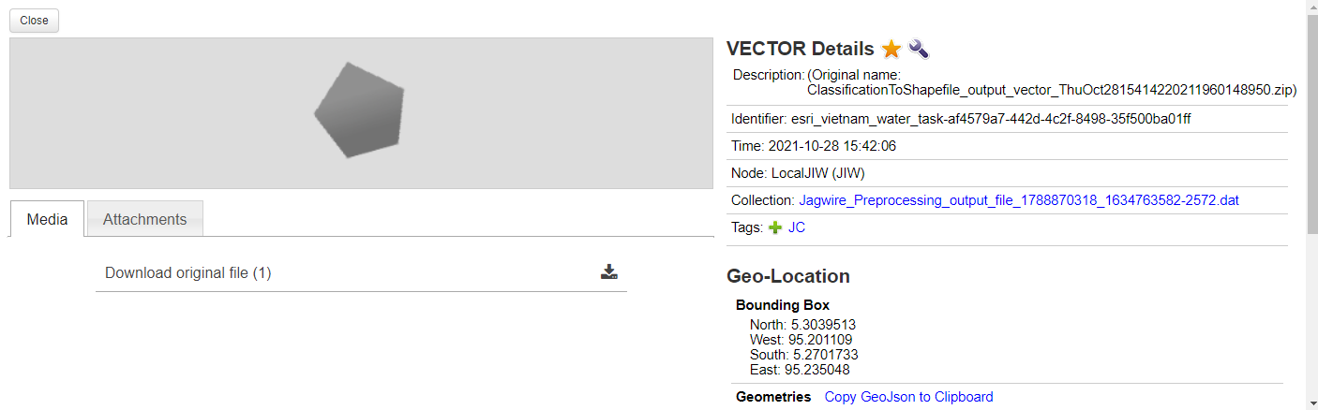
Water Task
7. Select product and download
Click here to Download

Slide 79
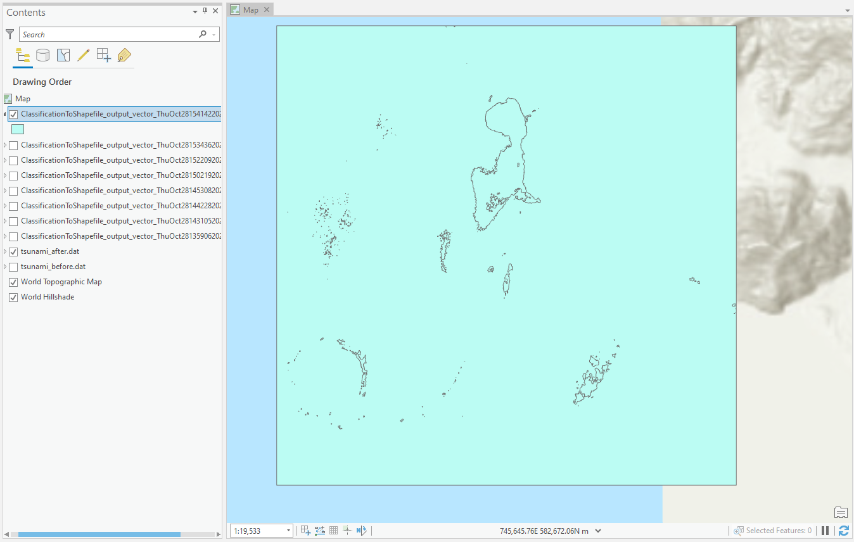
Water Task
8. Import into ArcGIS or ENVI for analysis

Slide 80

Questions?

